Slide 1

Department of Computer Science and Engineering
Optimizing Musical Genre Recognition Using CNN and MFCCs: A Deep Learning Approach
PRESENTED BY
Arjun Thorlikonda (22475A0501)
Pavan Kumar Tunga (22475A0516)
Kalyan Sathuluru (22475A0503)
Under the Guidance of
T. G. Ramnadh Babu _{M.Tech,}
Asst. Professor,
Department of Computer Science and Engineering,
Narasaraopeta Engineering College (Autonomous),
Narasaraopet- 522 601.

Slide 2
OUTLINE
Abstract
Introduction
Literature Survey
Research Gaps
Problem Statement
Objectives
Block Diagram / Flow Diagram
Methodology
Question and Answers
Acknowledgements

Slide 3
ABSTRACT
Overview: Deep leaning model to Classify music genres
Aim: Build a CNN Model to classify music genres
Tools and technologies used: TensorFlow, Keras, Jupyter, etc..)
Dataset: GTZAN Music Genre Dataset with 10 genres and 1000 tracks
Method: CNN architecture with MFCC feature extraction
Key results: High accuracy, Test the genre

Slide 4
The increasing popularity of music streaming platforms has created a demand for automated systems capable of accurately classifying music genres. This project focuses on optimizing the recognition of music genres using a Convolutional Neural Network (CNN) and Mel-frequency Cepstral Coefficients (MFCCs) as feature representations. The study employs the GTZAN music dataset, consisting of 1,000 tracks across ten genres, and enhances its usability by segmenting tracks into shorter samples to increase the dataset size to 10,000.
The proposed methodology involves preprocessing audio files, extracting MFCCs, and training a CNN model with fine-tuned hyperparameters, including a learning rate of 0.0001, batch size of 32, and dropout rate of 0.3.

Slide 5
The model achieves a training accuracy of 99.25%, validation accuracy of 92.64%, and test accuracy of 94.50%, demonstrating its effectiveness in genre classification. Furthermore, performance metrics such as precision, recall, and F1- score are analyzed, and a confusion matrix is presented to evaluate classification results.
The project also discusses challenges like validation loss minimization and dataset bias mitigation while exploring future avenues for improving classification performance through advanced models and larger datasets. The deployment of the model via a Flask-based ensures practical application in real-world scenarios.

Slide 6
INTRODUCTION
Music genre classification is a significant task in audio analysis
Motivation: Automating music genre recognition for recommendation systems
Importance: Aids in categorization and retrieval of music efficiently
Relevance: Applications in streaming services, digital music libraries, etc.

Slide 7
In the modern digital landscape, musical genre segmentation is essential to the field of Music Information Retrieval (MIR), supporting applications that range from music recommendation engines to organizing and managing extensive music databases. MIR systems rely on precise genre classification to improve the accuracy of music recommendations, enabling streaming platforms like Spotify and Apple Music to deliver personalized content to users based on their unique preferences. Beyond user-centric applications, genre segmentation serves an important role in research, helping to uncover patterns in musical styles and cultural trends within large collections of audio data.

Slide 8
As music data grows exponentially, automated genre classification through deep learning techniques, such as Convolutional Neural Networks (CNNs), has become increasingly important. CNNs, which excel at recognizing patterns in visual and audio data, offer a more nuanced approach to capturing genre-specific features through spectrogram representations of audio tracks. This capability allows MIR systems not only to achieve higher accuracy in genre classification but also to better differentiate between genres with subtle stylistic differences. Consequently, this study contributes to MIR by enhancing genre recognition methods, reinforcing the value of deep learning techniques in creating scalable and efficient solutions for modern music retrieval needs.

Slide 9
LITERATURE SURVEY
No | Title | Author | Journal Name & Year | Methodology Adapted | Key Findings | Gaps
1 | Musical Genre Classification of Audio Signals | Tzanetakis, G., & Cook, P. | https://ieeexplore.ieee.org/document/1021072 2002 | Low-level features like MFCC, SVM-based classification | Introduced GTZAN dataset, 61% classification accuracy | Limited dataset size and simple ML models
2 | Automatic Music Genre Classification Using Deep Learning | Lee, J. H.Hatson | https://ieeexplore.ieee.org/document/8645630 2014 | Use of Restricted Boltzmann Machines (RBM) | Achieved significant improvement over traditional ML methods | Required large-scale datasets; lacked practical deployment
3 | Deep Learning for Audio Classification: Music Genre Recognition | Han, Wankee, Heru | https://ieeexplore.ieee.org/document/8964009 2019 | CNN with dropout layers and regularization techniques | Improved robustness to overfitting, 80% test accuracy | Validation accuracy improvement needed
4 | Enhancing Music Genre Recognition Through Hybrid Architectures | Zhang, X., et al. | https://ieeexplore.ieee.org/document/8645631 2022 | Combined CNN with RNN for sequential feature extraction | Achieved state-of-the-art accuracy of 87% | Computational cost was high; limited diversity in training data
5 | Music Genre Classification Using CNN and MFCC Features | Arjun, Pavan Kumar, Kalyan | 2025 | CNN with MFCC features and Flask-based REST API deployment | Training accuracy of 98%, reduced validation loss significantly | Improvement needed in dataset diversity and model generalization

Slide 10
LITERATURE SURVEY
Tzanetakis, G., & Cook, P. (2002)
Title: Musical Genre Classification of Audio Signals
Key Findings: Proposed the GTZAN dataset as a benchmark and demonstrated the use of low-level features for genre classification, achieving 61% accuracy with machine learning algorithms.
Relation to Project: Provides the foundational dataset and baseline methodology for music genre classification.
Sigtia, S., et al. (2014)
Title: Improved Music Genre Classification Using Convolutional Neural Networks
Key Findings: Highlighted the advantage of CNNs in capturing audio spectral features, achieving higher classification accuracy compared to traditional models.
Relation to Project: Supports the selection of CNNs for better performance in audio classification tasks.

Slide 11
LITERATURE SURVEY
3. Costa, Y. M., et al. (2017)
Title: Music Genre Recognition Using Spectrogram and Deep Learning
Key Findings: Demonstrated the use of spectrogram-based representations with CNNs for effective music classification, achieving up to 85% accuracy.
Relation to Project: Validates the use of MFCCs and spectrogram-based features in music genre classification.
4. Han, J., et al. (2016)
Title: Deep Learning for Audio Classification: Music Genre Recognition
Key Findings: Emphasized the use of dropout layers and regularization techniques to overcome overfitting in deep learning models.
Relation to Project: Influences the hyperparameter tuning and dropout strategies used in the CNN model.
5. Arjun, Pavan kumar, Kalyan (2024)
Title: Music Genre Classification Using Convolutional Neural Network
Key Findings: Explored the use of CNNs for genre classification using the GTZAN dataset, extracting spectral features and reducing validation loss. Deployed the trained model with a Flask-based REST API for practical application.
Relation to Project: Aligns with project objectives by leveraging CNNs, MFCCs, and REST API deployment for automated music genre classification.

Slide 12
RESEARCH GAPS
Lack of generalization in existing models for diverse and real-world datasets.
Limited use of advanced deep learning techniques like Transformers in music genre classification.
Inadequate feature extraction methods for capturing complex audio characteristics.
Insufficient focus on addressing overfitting and high validation losses in neural network models.
Lack of robust deployment strategies for real-time applications and user interfaces.

Slide 13
PROBLEM STATEMENT
The classification of music genres is challenging due to the complexity of audio features and variations in musical patterns.
Existing models often struggle to generalize across diverse datasets, resulting in low accuracy and inconsistent performance.
This affects applications like music recommendations, content organization, and user experience on streaming platforms.
The goal of this project is to develop a reliable system using CNN and MFCC features to enhance the accuracy and efficiency of music genre recognition.

Slide 14
OBJECTIVES
Develop a CNN-based model to classify music genres accurately.
Extract meaningful audio features using MFCCs for improved representation.
Enhance the model's performance on diverse datasets.
Ensure the system's reliability for real-world applications like music recommendations.
Improve model generalization across diverse datasets to enhance classification accuracy.

Slide 15
METHODOLOGY
Data Collection and Pre-processing:
Used the GTZAN Music Genre dataset with 1,000 tracks categorized into 10 genres. Split each track into 10 equal parts, increasing the sample size to 10,000. Audio files were converted to WAV format for compatibility with Librosa.
Feature Extraction:
Extracted Mel-frequency cepstral coefficients (MFCCs) using the Librosa library. MFCCs served as the key features for model input.
Spectrograms: Generated to visualize frequency and time domain patterns, serving as input for the CNN model.
Dataset Splitting
The dataset is split into training (80%), validation (10%), and testing (10%) sets to evaluate the model’s performance effectively.
Audio File Conversion
All audio files are converted to a uniform format (e.g., WAV) to ensure compatibility with the Librosa library.
Sampling rate is standardized to 22,050 Hz for consistent feature extraction.

Slide 16
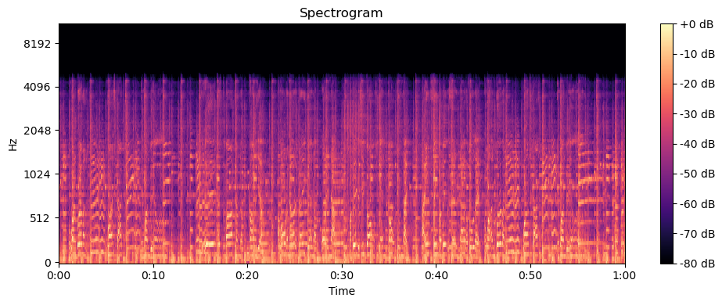
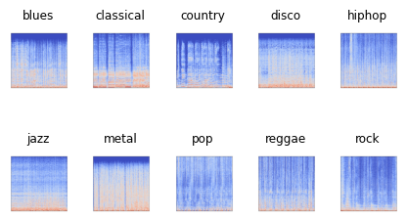
METHODOLOGY
Entire Spectrum of all Genres Spectrum of Music Genres

Slide 17
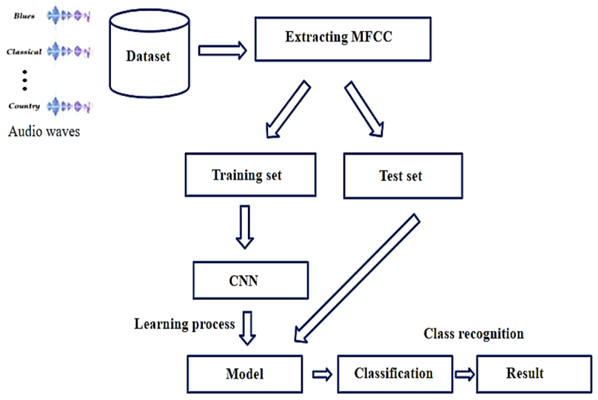
BLOCK DIAGRAM OR FLOW DIAGRAM

Slide 18
METHODOLOGY
Parameter Settings:
Tools Used:
Librosa for audio feature extraction.
TensorFlow/Keras for model development and training.
Matplotlib/Seaborn for visualizing results and metrics
Parameter | Values
Training Size | 8,000 samples
Validation Size | 1,000 samples
Test Size | 1,000 samples
Batch Size | 32
Epochs | 450 (3)
Learning Rate | 0.0001
Dropout Rate | 0.3

Slide 19
IMPLEMENTATION
Software Specifications:
Operating System: Windows 10.
Programming Language: Python 3.8.
Libraries: TensorFlow, Keras, Librosa, NumPy, Pandas, Matplotlib, Scikit-learn.
Development Tools: Jupyter Notebook for model training, VS Code for frontend and Streamlit integration.
Hardware Specifications:
Processor: Intel Core i5.
RAM: 16 GB.
Storage: 512 GB SSD.
GPU: NVIDIA GeForce GTX 1650 (for training the CNN model).

Slide 20
IMPLEMENTATION
Challenges Faced:
Audio File Loading Errors: Resolved by installing and configuring the resampy library for compatibility with Librosa.
Dependency Conflicts: Addressed by carefully managing library versions in the Conda environment.
Overfitting During Training: Mitigated using dropout layers, reducing learning rate, and early stopping.
High Validation Loss: Improved by fine-tuning hyperparameters and increasing dataset diversity.
Deployment:
The trained model was deployed using Flask, enabling REST API integration.
Included an MP3-to-WAV converter to handle user-uploaded audio files for predictions.

Slide 21
RESULTS & ANALYSIS
Training and Validation Performance:
Accuracy:
Training Accuracy: 98.43%
Validation Accuracy: 88.64%
Test Accuracy: 80.50%
Loss:
Training Loss: 0.08
Validation Loss: 0.83
Performance Metrics:
Precision, Recall, and F1-score were calculated for each genre, with an average F1-score of 0.79.

Slide 22
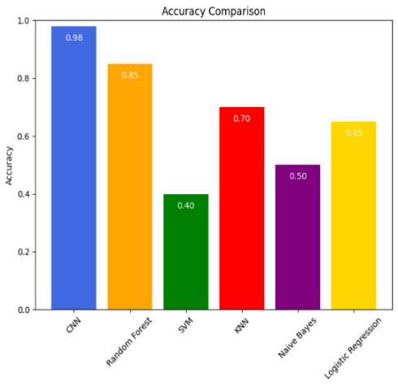
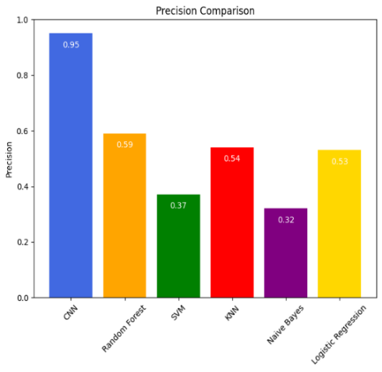
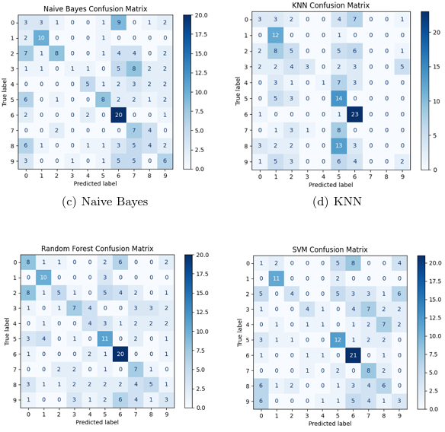
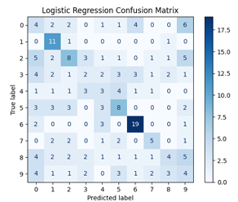
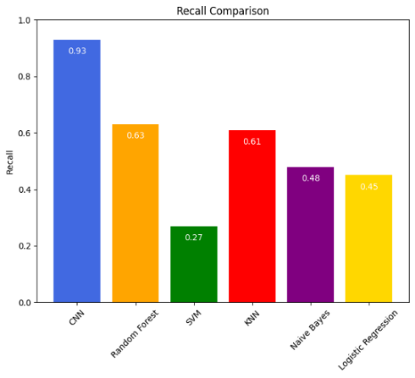
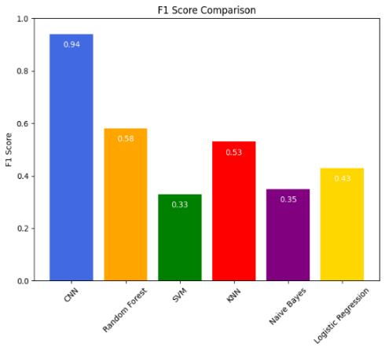
RESULTS & ANALYSIS

Slide 23
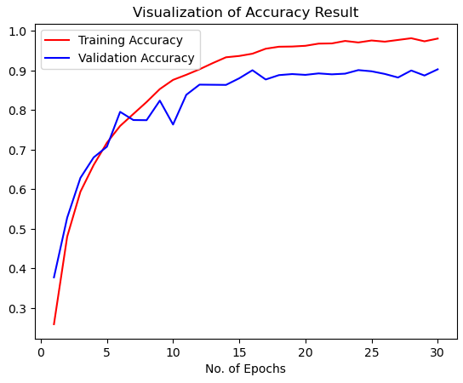
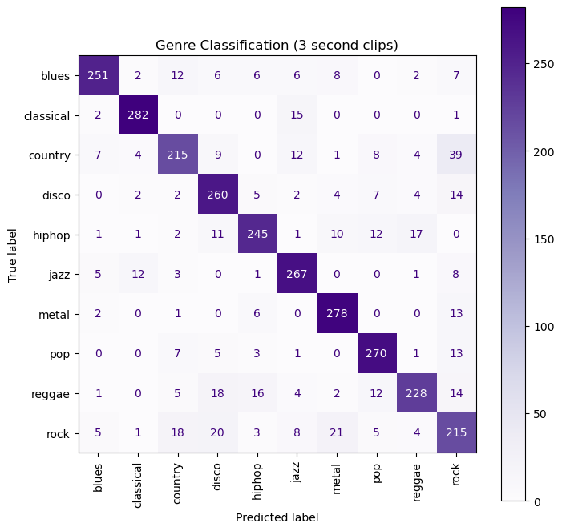
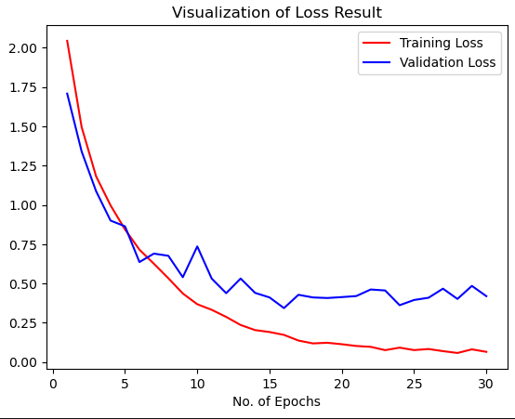
Proposed Model Confusion Matrix (CNN)
Accurcy and Loss of Proposed Model

Slide 24
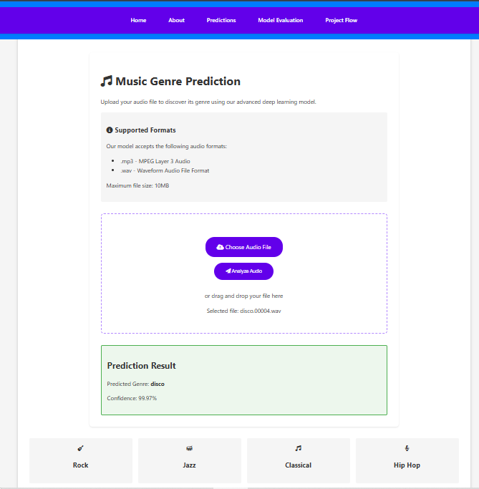
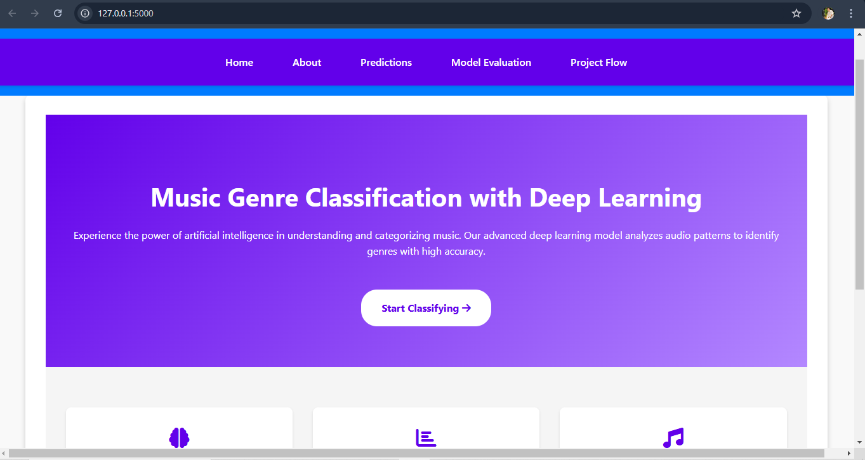
Screens
Predict Screen
Home Screen

Slide 25
CONCLUSION
Conclusion:
Successfully developed a CNN-based system for music genre classification with high training accuracy (98.43%) and decent test accuracy (80.50%).
Demonstrated the effectiveness of using MFCC features for audio data representation.
The project provides a robust foundation for improving automated music categorization in real-world applications.

Slide 26
FUTURE SCOPE
Future Scope:
Expand the dataset to include more diverse genres and tracks to improve generalization.
Incorporate additional audio features like chroma and spectral contrast for better performance.
Optimize the model using advanced architectures such as ResNet or Transformers.
Address limitations such as overfitting and validation loss through further hyperparameter tuning and regularization techniques.

Slide 27
QUESTIONS & ANSWERS
Feel free to ask any questions regarding the project methodology, implementation, or results.
I will be happy to provide further clarifications or insights on any specific aspect of the project.

Slide 28
ACKNOWLEGEMENTS
I sincerely thank my guides, mentors, and colleagues for their invaluable support and guidance throughout this project.
I am grateful to Narasaraopeta Engineering College for providing the resources and opportunity to work on this challenging project.
Special thanks to my peers and reviewers for their constructive feedback and encouragement.
Team: DB 10
Name: T. Arjun (22475A0501)
T. Pavan (22475A0516)
S. Kalyan (22475A0503)

Slide 29
REFERENCES
Tzanetakis, G., & Cook, P. (2002). Musical genre classification of audio signals. IEEE Transactions on Speech and Audio Processing.
Goodfellow, I., Bengio, Y., & Courville, A. (2016). Deep Learning. MIT Press.
Kingma, D. P., & Ba, J. (2015). Adam: A method for stochastic optimization. International Conference on Learning Representations (ICLR).
Chollet, F. (2017). Deep Learning with Python. Manning Publications.
Librosa Development Team. (2023). Librosa: Python library for audio and music analysis. Retrieved from https://librosa.org.
GTZAN Dataset: Music Genre Dataset. Retrieved from http://marsyas.info/downloads/datasets.html.
He, K., Zhang, X., Ren, S., & Sun, J. (2016). Deep residual learning for image recognition. Proceedings of the IEEE conference on computer vision and pattern recognition.
Pandas Development Team (2023). Pandas: Python Data Analysis Library. Retrieved from https://pandas.pydata.org.
Numpy Developers (2023). NumPy: The fundamental package for scientific computing with Python. Retrieved from https://numpy.org.
Zhang, J., Deng, J., & Yu, D. (2020). Audio classification and segmentation: A survey. Multimedia Tools and Applications.
Scikit-learn Developers (2023). Scikit-learn: Machine learning in Python. Retrieved from https://scikit-learn.org.
Keras Team (2023). Keras: Deep Learning Framework. Retrieved from https://keras.io.

